Slide 1

Predicting ICU Patient Length of Stay for Enhanced Resource Allocation
Tom Lever, Karis Roberts, Lingzhen Zhu
Notes:
Hello, I am xxxx and I am a part of team #4, along with xxxx, and xxxx.
we will be presenting on our work predicting ICU patient length of stay to enhance resource allocations in a clinical setting. This project leverages a machine learning approach using a Random Survival Forest model.

Slide 2

Get to the Bottom Line Up Front.
Key Message: Our model predicts ICU patient Length Of Stay (LOS), enabling better resource allocation and improved patient care.
Notes:
Bottom line up front, our model can predict the length of stay for patients in the ICU, which enables better resource allocation and ultimately improves patient care. This is crucial for optimizing the use of beds, staff, medication supplies, and equipment in Intensive care units.

Slide 3
Accurate LOS Prediction Matters.
Challenge: Unpredictable ICU admissions complicate resource management.
Importance: Optimizing resources like beds, staff, and equipment is crucial for streamlining patient care and operation efficiency.
Solution: We create a machine learning algorithm to predict patient LOS in the ICU for resource planning.
Notes:
Intensive Care Units (ICUs) are a cornerstone of modern healthcare, offering specialized care to critically ill patients. Yet, managing these units comes with its challenges, particularly due to the unpredictable nature of patient admissions and the varying lengths of stay (LOS) of the patients. Accurate prediction of LOS is essential for optimizing the allocation of beds, equipment, and staff, ensuring that resources are used effectively.
Our motivation is clear: by improving planning and resource management, we can reduce costs, enhance patient outcomes, and ultimately deliver better healthcare. Through the development of a reliable LOS prediction model for ICUs, we aim to empower healthcare professionals with insights that can support more informed decision-making, enabling critical care services to operate with greater efficiency and effectiveness.

Slide 4
We Leverage Random Survival Forest for Prediction.
Approach: We use a Random Survival Forest (RSF) that predicts LOS based on patient attributes.
Method: RSF is an ensemble learning method designed for survival analysis.
Data Source: We trained our RSF on the MIMIC IV dataset, which includes vital signs, demographics, and disease information.
Advantage: Our model predicts numerical LOS values and probability distribution curves.
Notes:
We developed a machine learning model using the random survival forest approach.
Survival analysis is a branch of statistics that focuses on analyzing time-to-event data.
Random Survival Forest is an ensemble learning method designed for survival analysis. For survival analysis, a Random Survival Forest estimates the probability that a random LOS exceeds a specific duration for each individual by splitting data at decision nodes based on features and their association with the LOS.
This model is trained on the MIMIC IV dataset which includes vital signs, demographic data, and disease information from ICU patients. The goal is to predict the Length of Stay for ICU patients based on these attributes.
Survival analysis offers the advantage of predicting numerical LOS values and the model estimates can be used to generate a probability distribution curve for LOSs. A Probability Distribution Function is a distribution of likely LOS values, showing where the probability is most concentrated over a range of possible LOS durations.
Now I am going to hand it over to xxxx to talk to the key predictors of the model

Slide 5
Key Predictors Drive Accurate Predictions.
The Goal: Create an RSF that predicts survival times/ LOS.
Significant Predictors: Max heart rate, respiratory rate, and oxygen saturation are significant predictors.
Metrics: Mean Squared Error (MSE) of 49.622, Concordance Index of 0.821.
Notes:
Thanks xxxx,
To reiterate, we created a Random Survival Forest that predicts survival times / Lengths Of Stay.
Our model was trained on a feature matrix of about 60 predictors, and about 4,000 rows / ICU stays.
The most significant predictors identified by our model are heart rate, respiratory rate, and oxygen saturation.
Knowing key predictors may help hospital staff make decisions about resource allocations.
Our model had a Concordance Index of 0.821, a Mean Squared Error of about 49 square years, and a Root Mean Squared Error of about 7 days.
The Concordance Index measures the probability that, for any two randomly selected ICU stays, our model correctly predicts which one has the shorter Length of Stay (LOS). 0.5 indicates that our model is no better than a random guesser. 1.0 indicates that our model ranks perfectly.
Given the Concordance Index is greater than 0.8, our model may be a valuable tool for ICU resource managers.
MSE quantifies the average squared difference between actual and predicted LOS.
MSE reflects the variance of prediction errors.
A lower MSE indicates that predicted LOS values are closer to actual LOS values.
Given a Root Mean Squared Error of about 7 days, point predictions of single Lengths Of Stay may be inaccurate.
Considering the Concordance Index and some performance visualizations, our model overall performs well.
In other words, our model best estimates the ball park of the Length Of Stay of a patient. Our model has some error in predicting exact Lengths Of Stay.

Slide 6
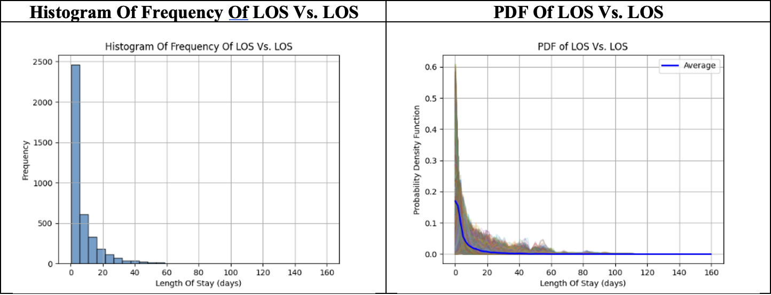
Predicted and Observed PDF are the Same.
Notes:
Our model predicts a Probability Density Function that mirrors the distribution of actual Lengths Of Stay.
On the left is a histogram of frequency of LOS vs. LOS for our entire dataset.
On the right is a graph of many PDFs. There is one PDF for each ICU stay. The thick blue curve is the average PDF.
The two graphs look similar. Our model effectively predicts the distributions of Lengths Of Stay for various ICU stays.

Slide 7
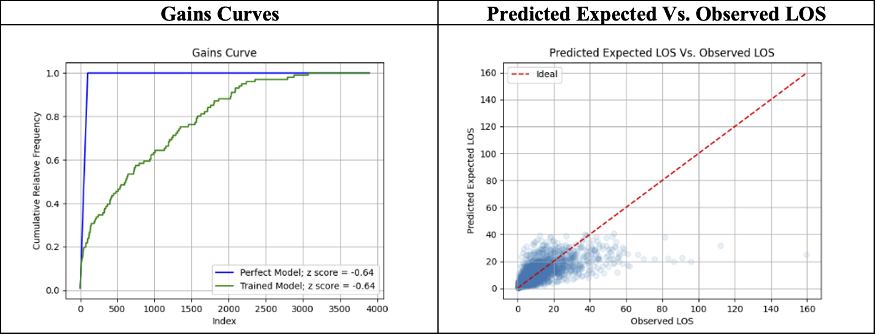
Our Model Performs Well Overall.
Notes:
Let’s consider performance visualizations.
On the left is a Gains Curve. A Gains Curve may be interpreted as an ROC Curve. Our Gains Curve indicates that our model has learned about the relationship between Length Of Stay and our predictors.
On the right is a density plot. The graph plots predicted expected LOS vs. observed LOS. A predicted expected Length Of Stay is generally of the same order of magnitude as the corresponding observed Length Of Stay. Unfortunately, predicted expected Length Of Stay seems to vary logarithmically with observed LOS. This is probably due to the fact that there are far more short Lengths Of Stay than long ones in our data set.
Further directions may be to balance our dataset or apply corrective measures to linearize our model’s predictions.
Now I am going to hand it over to xxxx to discuss Exploratory Data Analysis and further directions.

Slide 8
Comprehensive Data Underpins Model Reliability
Dataset: 3,896 rows.
Features: Subject ID, hospital admission ID, ICU stay ID, vitals, demographics, and diseases.
Notes:
The feature matrix used in our model comprises 3,896 rows and includes columns for subject ID, hospital admission ID, ICU stay ID which are used to identify the patients and their hospital visits. The data also consists of columns that include information on vitals, demographics, and diseases. There are no null values in the data. This comprehensive dataset underpins the model's reliability and accuracy.

Slide 9
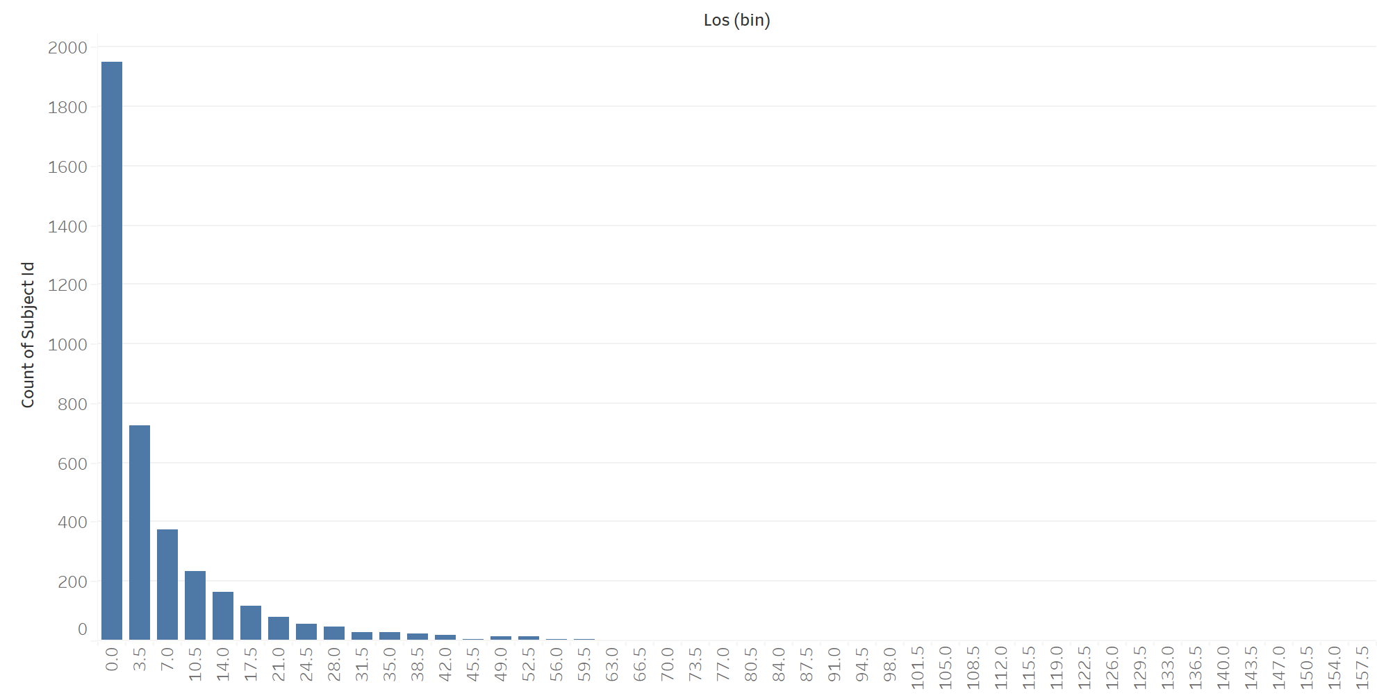
Exploratory Data Analysis Reveals Key Insights
LOS Distribution is skewed
Indicating data imbalance
Notes:
We performed exploratory data analysis to reveal key insights into the data before creating our model.
Objective: Understand the dataset and identify important patterns to inform resource allocations.
We found that the LOS distribution in the data set is skewed right, indicating a data imbalance because there are few examples of long stays or deaths in the data. This imbalance can lead to bias with classification models, and Predicting LOS using regression would be more appropriate than a classification model for this problem. Random Survival Forest was chosen because it is more resilient to the skewed training data.

Slide 10
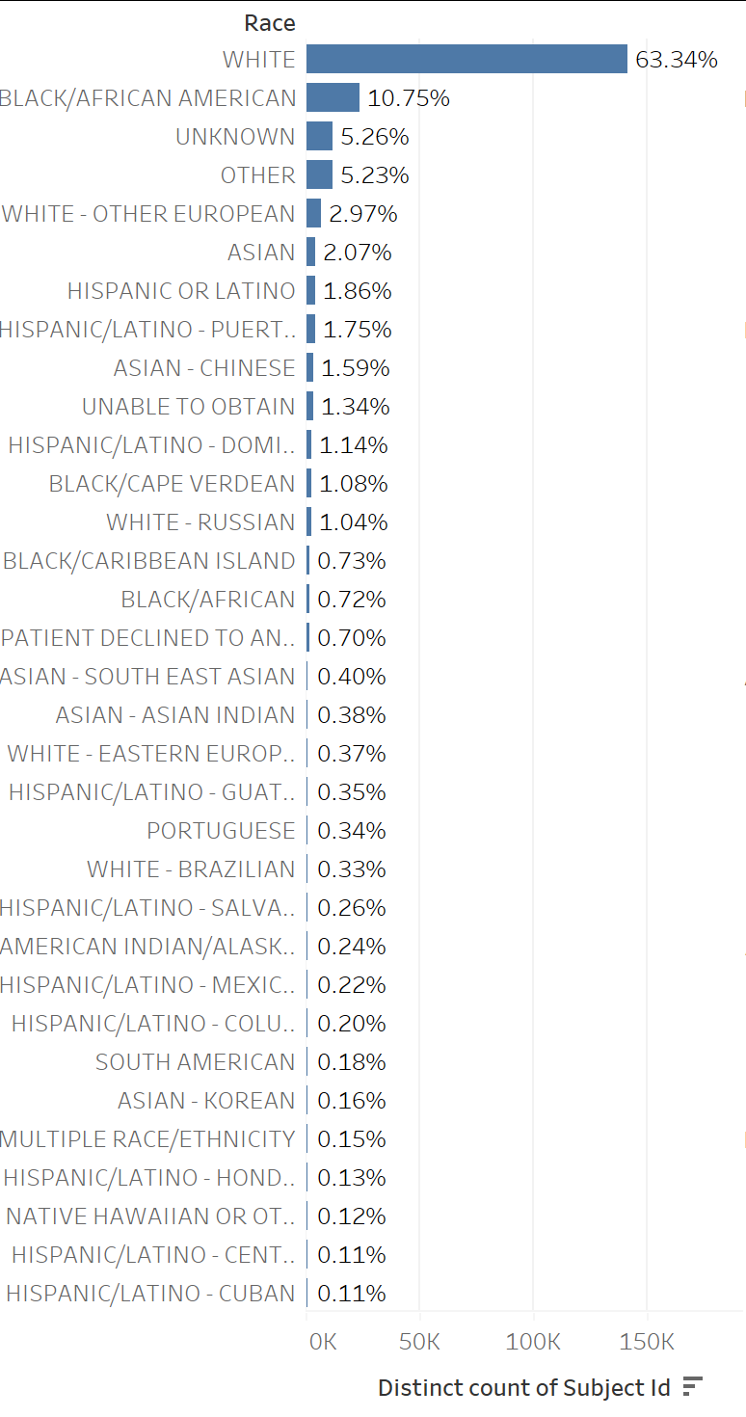
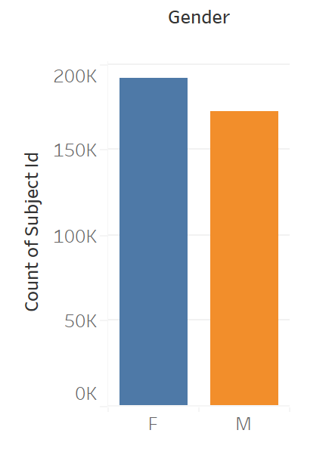
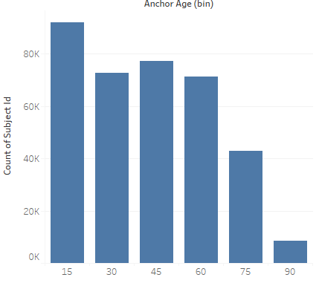
Exploratory Data Analysis Reveals Key Insights
Discussion: Why demographic data (age, race, and gender) not be key predictors
Notes:
We also found in our model that age is relatively unimportant, while race and gender are even less important. This may be due to the relatively small number of patients in certain age, race, or gender categories, which can lead to these demographic predictors being undervalued.
It’s possible that people of certain ages, races, or genders receive less quality care that results in LOSs that are too short, too long, or even missing or inaccurate records.
A further direction may be to balance observations of LOS and to ensure that all patients received comparable care.

Slide 11
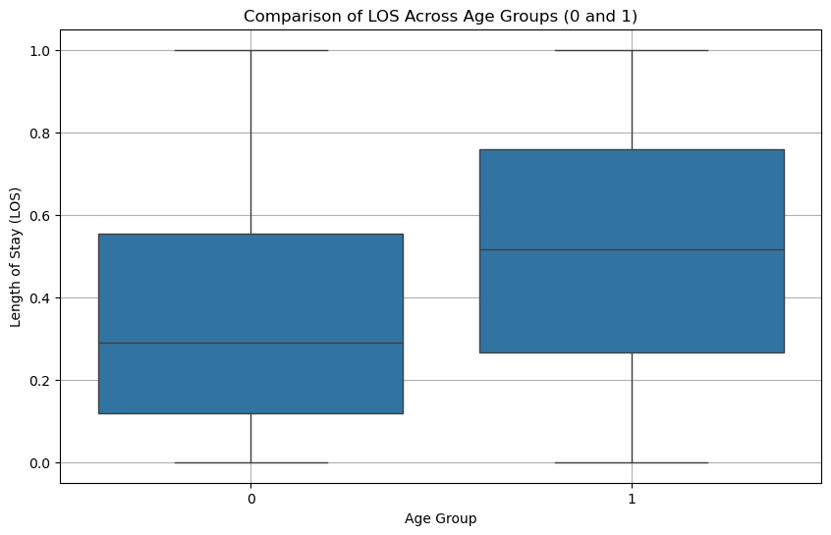
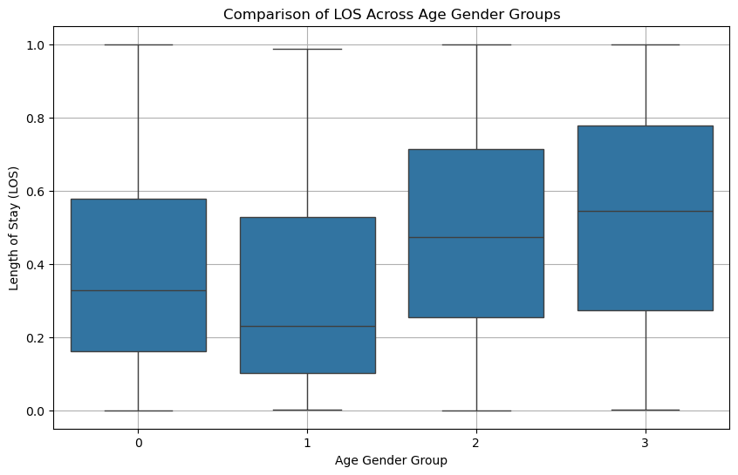
Exploratory Data Analysis Reveals Key Insights
Notes:
We performed exploratory data analysis to reveal key insights into the data before creating our model.
Age, race, and gender show minimal impact of LOS predictions.
We found that the LOS distribution in the data set is skewed right, indicating a data imbalance because there are few examples of long stays or deaths in the data. This imbalance can lead to bias with classification models, and Predicting LOS using regression would be more appropriate than a classification model for this problem. Random Survival Forest was chosen because it is more resilient to the skewed training data.
We also found in our model that age is relatively unimportant, while race and gender are even less important. This may be due to the relatively small number of patients in certain age, race, or gender categories, which can lead to these demographic predictors being undervalued.
It’s possible that people of certain ages, races, or genders receive less quality care that results in LOSs that are too short, too long, or even missing or inaccurate records.
A further direction may be to balance observations of LOS and to ensure that all patients received comparable care.

Slide 12
Future Directions
Large dataset handling: distributed computing
Try Bayesian Regression Model
Pipeline enhancements:
- Address data imbalances (resample)
- Feature engineering
- Incorporate more variables (e.g., medication data)
- Expand to predict patient mortality.
Notes:
There is room for improvement with this model. Future directions should address:
data imbalances related to the Length of Stay and the small number of patients in certain demographic categories
The model could also be improved by incorporating medication information,
and potentially the model could be expanded to include patient mortality predictions.
These enhancements aim to further refine the models applicability.

Slide 13
Conclusion: Transforming ICU Operations
Summary: Our model serves as a proof of concept for predictive analytics in healthcare, allowing for more predictive ICU operations which can improve patients care.
Future Enhancements: Integrate additional features, data transformations, and refined predictions.
Notes:
In conclusion, our model demonstrates a significant potential for enhancing ICU operations. By forcasting length of stay, ICU staff can better plan for the use of critical resources, leading to more effective and efficient patient management. This project serves as a proof of concept for predtictve analytics in a healthcare setting, paving the way for more efficient ICU operations.
Thank you for time!

